Slide 1
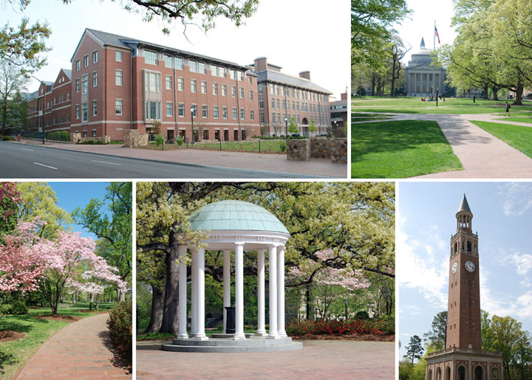
Report on SoCG 2012 / CG:APT
Jack Snoeyink
UNC Chapel Hill

Slide 2











Special thanks to
Space, staff: UNC Chapel Hill & Dept of CS
Sponsorship: ACM, SIGACT, SIGGRAPH
Students: Elsevier
Prizes: Mentor Graphics
Plenary speakers: RENCI
CG:APT workshops: Geomagic, NSF
USB wristbands: Springer Verlag

Slide 3





Special thanks to
Space, staff: UNC Chapel Hill & Dept of CS
    Melissa Wood
    Director of Research Support and Communications,
    and her staff: Kelli, Anna, Crystal
    Brian White
    IT Director, and his staff: bil, David, Alan,…
    Student volunteers: David, Vishal, Matt, Shawn,
    Aram, Sajal, Clinton, Steve, Hina, Siddharth

Slide 4
Registration by country
United States | 119 | Switzerland | 3
Germany | 19 | Brazil | 2
France | 11 | Japan | 2
Canada | 8 | Korea, Republic of | 2
Israel | 7 | United Kingdom | 2
Denmark | 4 | Australia | 1
Netherlands | 4 | China | 1
Austria | 3 | Czech Republic | 1
Greece | 3 | Norway | 1
Hong Kong | 3
 |  | TOTAL | 196

Slide 5
Registration types & income
non-ACM Member CG Week | 44 | $15,452.00
ACM Member CG Week | 54 | $14,027.50
ACM Member SoCG only | 2 | $445.50
CG:APT only | 6 | $1,456.50
One day in CG Week | 7 | $750.00
Student CG Week | 81 | $13,423.00
Student SoCG only | 1 | $262.00
Student CG:APT only | 1 | $75.00
TOTAL | 196 | $45,891.50

Slide 6
Main budget items
categories | K$
ACM food | 10.0
CG:APT food | 9.8
Banquet | 9.2
Dorm accomm | 8.6
Invited speakers | 5.0
ACM proceedings | 4.3
ACM SIG fees | 3.2
ACM contingency | 2.0
Administration | 2.0
Reg online | 1.5
Transportation | 1.0
TOTAL | 56.6

Slide 7
Organizational thoughts (added)
Young Researchers’ Forum and student presentation prize dramatically increased student participation. Definite win; thanks to Sandor. I had put the YRF in a 60-seat room, which early in the week was nearly full, giving it a good feeling of energy.
We had too many workshops, but all of high quality, and all added to the event. If anything, I would have changed it so that the plenary speakers each tied into a workshop, as Chris Bishop did and Rien van de Weijgaert sort of did (after his workshop completed.) These were organized before the workshops, however. The plenary talks do give the only time at which everyone can be expected to be there, so anchor the fast forward session. Fast forward was almost required to give attendees an overview of what was on offer for the afternoon parallel sessions. Letting all YRF speakers introduce their talks gave them exposure.
Workshops were not forced to a fixed schedule, just shifted slightly to overlap breaks. I had feared that too many had long talks, and some people have suggested that we would need more synchronizing, but it seemed to work to let people vote with their feet.
Some sponsors jumped at the chance of supporting students or prizes. I aimed for a number of smaller donations (1–4K$) by contacting people with a shopping list: $w for prizes, $x for student registration discounts or banquet tickets, $y for an invited speaker sponsorship or $z for speaker registration discounts for workshops. Workshop abstracts were helpful in soliciting donations from sponsors; those who sent abstracts at the last minute wound up not getting as much sponsored benefits.
UNC and UNC CS provided all space and AV equipment rent-free, a significant savings over last year. Dorm accommodation is still appealing: the 58 in dorms were 15 non-students, 43 students. I had not considered the benefits of our lobby space until I saw how effectively it was used each afternoon. Plan space for informal discussions (& food) even during workshop sessions.
The UNC staff took care of many, many details that made things go smoothly or saved money: signs outside each session with daily schedules, signs to rooms, printing names on both sides of the badges, multiple food stations (including letting catering know that they should mix bagels on the trays), food preparation (making our own fruit parfait or salads instead of catering), tech staff in each session … Their work was a valuable contribution.
The arrangement of taxis to the airport was begun informally at the last minute by one of the staff and quickly became a more formal thing. We could have done better by planning for that earlier.
Print proceedings demand was low (we sold 25 of 100) since we had USBs. ACM proceedings prices have gone up – it would have been $6.7K for 200, so we ordered 100 at $4.2K, which was the price to have ACM make 200 USB sticks. Donated USBs let us offer both.
We had to process dorm registrations, so we used a university account and not an ACM account to avoid assessing SIG fees. This did somewhat increase costs by ~700 for banking and for on-line registration, since ACM has negotiated reduced fees with regonline.com. But since, all donation income and all expenses for the CG:APT workshops, lunches, banquet, and invited speakers were under a second, non-sponsored, non-guaranteed budget, we saved $4-5K in SIG fees.
Advice for budgeting with ACM: don’t be overly conservative or you’ll have to return a surplus. Argue income up: 1. attendance will be high because of special events, 2. people will register late, and 3. there will not be so many students. Argue per-person costs down. Advice from a prominent previous chair: Turn in your technical meeting request form (TMRF) late (8 months instead of 18) so that they will just be glad to get it. To which I add, even if you receive an automatic confirmation email, they may still lose you TMRF for 3 weeks.

